Slide 1
Conflict of Interest Reporting
January 16, 2024

Slide 2
Conflict of Interest
What is it?

Slide 3
Conflict of Interest
Definitions
Research Conflict of Interest –
a potential or actual research COI exists when commitments and obligations to the successful conduct of a research project are likely to be compromised, or perceived to be compromised, by a person’s outside interests or commitments, especially financial.
may create an undue risk that an individual’s judgement or actions regarding a primary interest of the University may be inappropriately influence by a secondary Financial Interest.
Conflict of Commitment or “COC” in research may arise in situations when time allocation creates a risk of divided loyalty between the University and an outside entity.

Slide 4
Conflict of Interest
Definitions
Significant Financial Interest (“SFI”) - the receipt by an Investigator or an Investigator’s Immediate Family Member of anything of monetary value, including but not limited to the following, provided they appear to be reasonably related to the Investigator’s Institutional Responsibilities:
Non-publicly traded entity: if the value of any remuneration received from any foreign or domestic, non-publicly-traded entity over a 12-month period, when aggregated, exceeds $5,000, or when the Investigator or the Investigator’s Immediate Family Members hold any equity interest.
Publicly traded entity: Any equity interest, including stock options in any foreign or domestic publicly-traded entity held by an Investigator and the Investigator’s immediate family members, that, when aggregated, exceeds 5% ownership interest in any single entity or a current value of $5,000, as determined through reference to public prices, recent financing events, or other reasonable measures of fair market value;
Salary, consulting fees, honoraria, royalties, and other payments received directly from a single outside entity that, when aggregated for the Investigator and the Investigator’s Immediate Family Members, exceeds $5,000 over a 12-month period;
Any income received from rights in Intellectual Property (e.g., patents, copyrights), as measured over a 12-month basis;
Any sponsored or reimbursed travel related to Institutional Responsibilities, regardless of dollar amount;
Any venture or other capital financing.

Slide 5
Conflict of Interest
Definitions
The term SFI does not include:
Salary or supplementary payments from the University or its affiliates;.
Income from seminars, lectures, or non-promotional engagements sponsored by governmental or non-profit entities;
Income from service on advisory committees or review panels for governmental or non- profit entities;
Royalties, milestone payments, licensing fees, or other remuneration paid by the University, or its affiliates to the Investigator if the Investigator is currently employed or otherwise appointed by the University or the Old Dominion University Research Foundation.

Slide 6
Conflict of Interest
Policies
Policy #5201 Research Conflict of Interest https://ww1.odu.edu/about/policiesandprocedures/university/5000/5201
Current version effective: October 1, 2020, is currently under review.

Slide 7
Conflict of Interest
actual
perceived
How is it addressed?
Training
Disclosure
Management or Mitigation

Slide 8
Conflict of Interest
Who Cares?
Old Dominion University ODU Research Foundation
“The purpose of this policy is to outline Old Dominion University’s approach to identifying, reporting, evaluating, managing, and resolving actual and potential research conflicts of interests and commitment to ensure the integrity of the University’s scholarship, research, sponsored programs, evaluation, and administration is not threatened.”
“Disclosure by Investigators of financial, personal, or professional relationships that raise a potential COI/COC or its perception is at the heart of the University’s COI/COC policy and is a prerequisite for determining whether a conflict, once recognized, can be managed or reduced or, in some cases, eliminated. – ODU Research Conflict of Interest and Commitment Policy (draft version)

Slide 9
Conflict of Interest
Who Cares?
Public Health Service
“….Promoting Objectivity in Research (FCOI regulation), establishes standards that provide a reasonable expectation that the design, conduct, or reporting of NIH-funded research (grants and cooperative agreements) will be free from bias resulting from any Investigator’s conflicting financial interest.” – PHS Regulations (August 2011) https://grants.nih.gov/grants/policy/coi/index.htm
Department of Energy
“…. establishes standards that provide a reasonable expectation that the design, conduct, and reporting of projects wholly or in part funded under Department of Energy (DOE) financial assistance awards (e.g., a grant, cooperative agreement, or technology investment agreement) will be free from bias resulting from financial conflicts of interest or organizational conflicts of interest. – DOE Regulations (December 2021) https://www.energy.gov/management/department-energy-interim-conflict-interest-policy-requirements-financial-assistance

Slide 10
Conflict of Interest
Who Else Cares?
National Science Foundation
“NSF requires each grantee organization employing more than fifty persons to maintain an appropriate written and enforced policy on conflict of interest and that all conflicts of interest for each award be managed, reduced or eliminated prior to the expenditure of the award funds. If the organization carries out agency-funded research through subrecipients or collaborators, the organization must take reasonable steps …
…must ensure that investigators have provided all required financial disclosures at the time the proposal is submitted to NSF. It must also require that those financial disclosures are updated during the period of the award, either on an annual basis, or as new reportable significant financial interests are obtained.” – NSF Regulations (June 2020)
https://www.nsf.gov/pubs/policydocs/pappg20_1/pappg_9.jsp
Disclosure & Manage or Mitigate

Slide 11
Conflict of Interest
Who Must Disclose and Take the Training?
Investigators » Principal Investigator (PI), Co-Principal Investigators (Co-PIs), and any other Key Personnel, regardless of title or position, who is responsible for the design, conduct, or reporting of research or sponsored project activities conducted under the auspices of the University/ODU Research Foundation, which may include collaborators or consultants.
PI has ultimate responsibility for the conduct of a research project.
Co-PI is also obligated to ensure the project is conducted in compliance with applicable laws and regulations and institutional policy governing the conduct of sponsored research.
The PI determines who is an Investigator on a project.
What is “design, conduct, or reporting of research?”

Slide 12
Conflict of Interest
What is “design, conduct, or reporting of research?”
Research design is the creation of the plan, the strategy, the methodology, the procedures, and the structure of conducting a research study. Anyone involved in creating, developing, or substantively contributing to those aspects of scientific research is subject to the regulations. Similarly, persons who materially influence the research questions pursued are subject to the regulations.
Conduct of research pertains to the direction, execution, or management of the study plan. It includes all aspects of carrying out a study, including subject recruitment, selection, enrollment, or retention; data or specimen collection, analysis or interpretation; maintenance of regulatory binders and other study documents; data and safety monitoring, study drug or device accountability, and management of study-related records.
Reporting of research includes the reporting and attribution of adverse events; the presenting of data/results; submitting information to the IRB (e.g., continuing review); completion of case report forms; and contributing to the presentation or publication of the research.
It is impossible to detail every component of what constitutes design, conduct, or reporting of research.
Some interpretation by PIs will be needed.
ODU expects all personnel to make a good faith effort to meet the spirit of the COI training and disclosure requirements and to seek guidance from the Office of the Research AVP for Compliance, as needed.

Slide 13
Conflict of Interest
What is “design, conduct, or reporting of research?” (Cont.)
Tips:
Key Personnel are always considered Investigators by virtue of the definition of Key Personnel.
Key Personnel are not administrative personnel or individuals who perform routine, pre-defined, or incidental tasks related to the project.
Being paid off of a grant or contract does not necessarily make one a Key Personnel.

Slide 14
Conflict of Interest
How To Train & How Often
ODU Research Portal – My COI
Initial COI Disclosure requires your acknowledgment that you reviewed the Training documentation provided before transitioning into your disclosures.
Every four (4) years training is required to be acknowledged, or more if otherwise directed.

Slide 15
Conflict of Interest
How to Disclose & How Often
Disclose annually in ODU Research Portal – My COI and within 30 days of discovering or acquiring a new SFI.
Disclosure Window: January – end of February of each year*
Your disclosure covers the prior 12 months.
Continue to update your disclosure through the year to add, remove, or modify external interests.
Throughout the year,
At time of proposal,
At time of award.
* COI Disclosure Window may be extended during new system implementation year.

Slide 16
Conflict of Interest
Travel Disclosures
Investigators participating in PHS or DOE-funded research are required to report on their annual COI Disclosure the occurrence of any Reportable Travel.
Travel that is paid for, sponsored, reimbursed, or otherwise funded by outside activities may become a conflict.
Any reimbursed or sponsored travel must be disclosed by Investigators.
Professional societies, foreign institutions of higher education, for-profit entities and non-profit entities are a few examples of outside entities that require disclosures.
Otherwise, travel paid for by the University, federal, state, or local government agencies, US higher education institutions, US academic teaching hospitals, US medical centers or research institutes affiliated with a US institution of higher education, generally do not need to be disclosed.

Slide 17
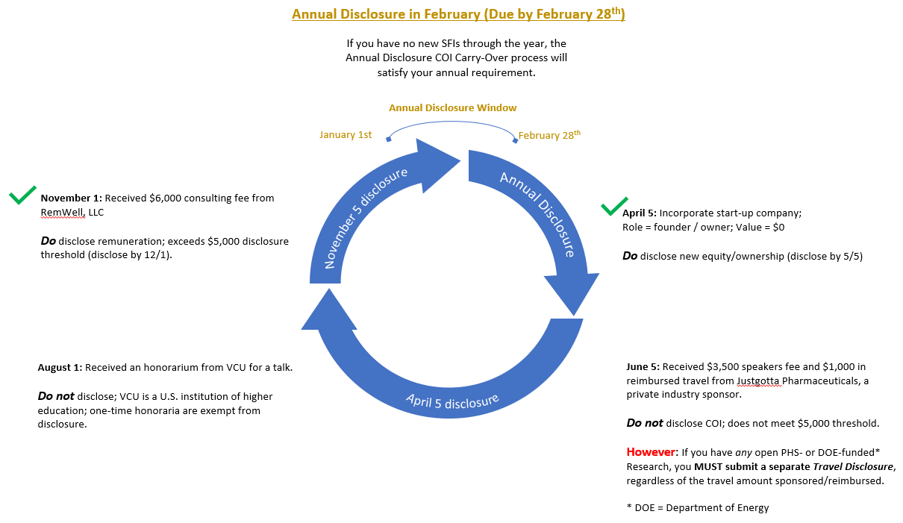
Conflict of Interest
Annual Disclosure Cycle

Slide 18
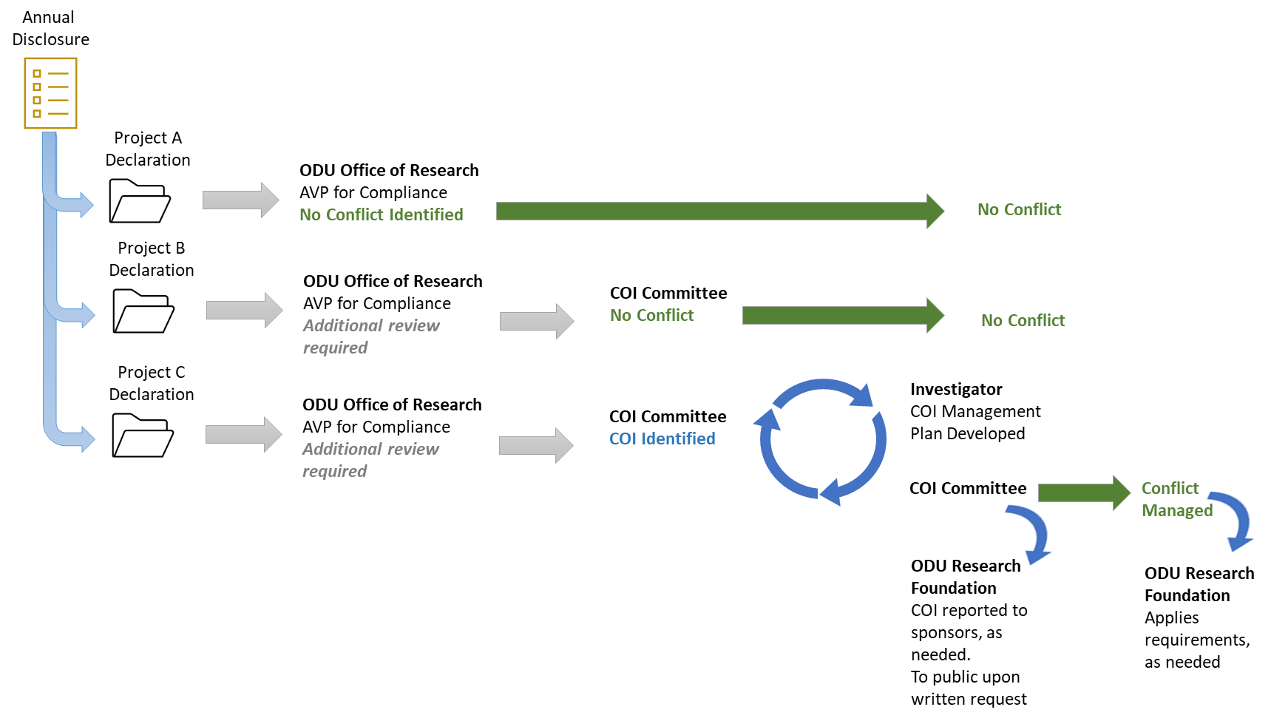
Conflict of Interest
Disclosure Review Cycle

Slide 19
Conflict of Interest
Consequences
False Claims Act (31 U.S.C. 3729 et seq.)
Researchers who make false certifications because of failure to disclose COI’s are subject to liability.
University/ODU Research Foundation who make false certifications because of failure to be in compliance and enforcement of policy and procedures.
University is subject to liability for failure to disclose known conflicts (See, e.g. Gelsinger v U Penn).
Loss of funding.

Slide 20
Conflict of Interest
Questions about COI?

